Slide 1
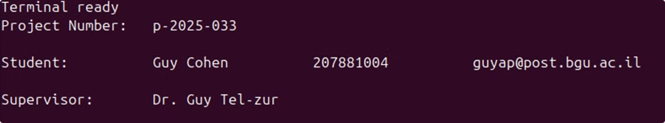

RISC-V Soft-Core Processor Implementation on Lattice IceBreaker FPGA
This presentation explores the implementation of a RISC-V soft-core processor on the Lattice IceBreaker FPGA using only open-source tools.

Slide 2
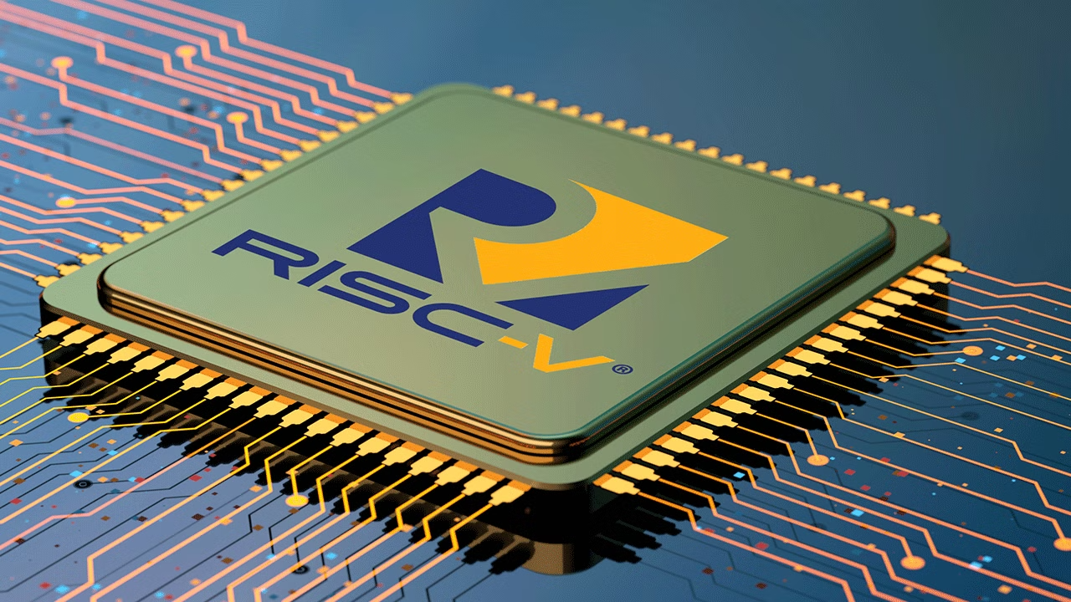
Introduction – Problem & Project Goal
Project Goal
Problem Statement
This project aims to implement a RISC-V soft-core processor on the Lattice IceBreaker FPGA using only open-source tools.
The high cost of commercial FPGA development tools limits accessibility for students, researchers, and developers.

Slide 3
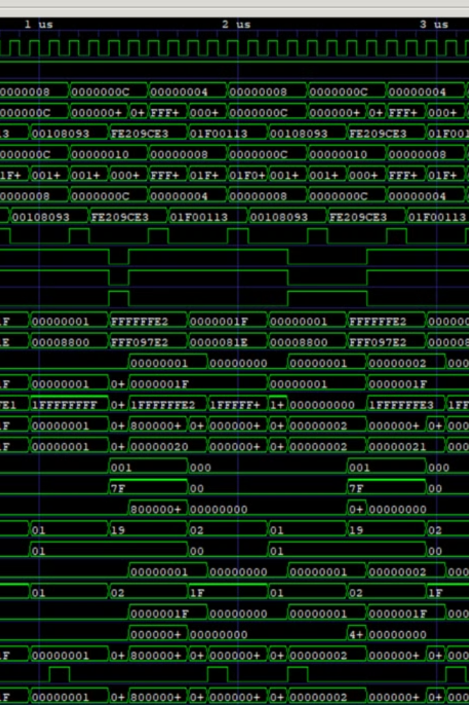
Project Objectives
1
Cost-effective FPGA development
2
Demonstrating feasibility
Utilizing only free, open-source tools.
Designing a working RISC-V soft-core processor.
3
Providing an educational and practical platform
For hardware design.

Slide 4
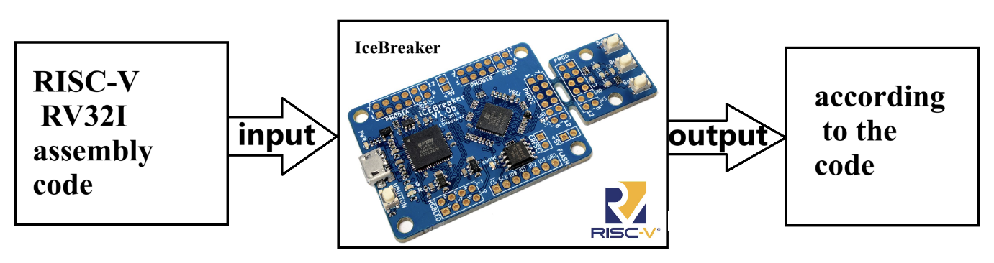
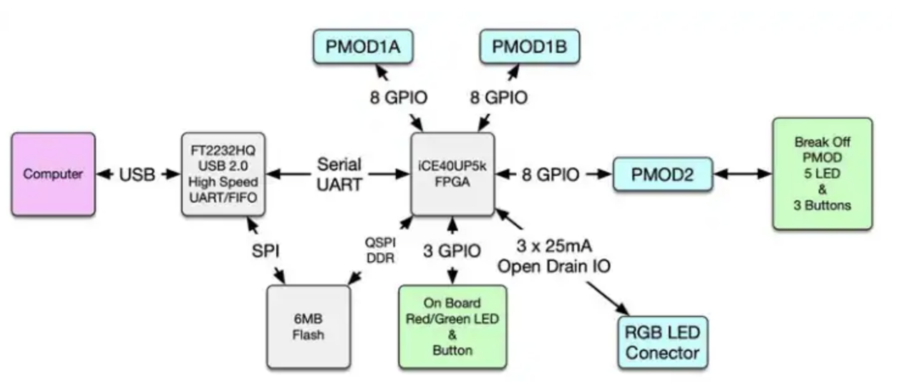
Project Contents
Hardware
Software
Testing
The Ice Breaker FPGA board serves as the physical environment for implementing the RISC-V processor.
The RISC-V processor design is written in Verilog, defining its functionality and components.
Rigorous testing ensures the functionality and correctness of the implemented RISC-V processor.

Slide 5



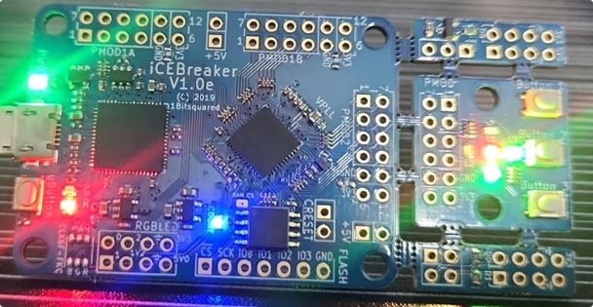

Chip Functionality Tests
Blinky
led-green
blink
Blinking the Green LED.
Turning the on board Green LED on but all the other controllable LED off.
Blink the on board Red and Green LEDs as well as the 5 LEDs found on the default PMOD P2 module.
buttons
Example of controlling the LED using the tact buttons on the board.

Slide 6

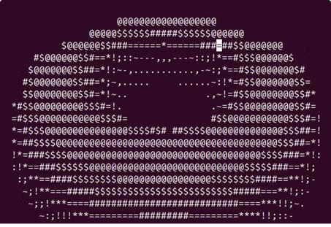
FemtoRV Quark Single Cycle Implementation
1
Assembly Code Execution
The processor can run assembly programs and transmit output via UART to the terminal.
2
C Code Execution
The processor can run C programs and transmit output via UART to the terminal.
3
SPIFLASH Protocol
Large programs can be flashed to the flash memory using the SPIFLASH protocol.

Slide 7





Challenges and Solutions
Openloader Availability
The openloader software for flashing memory is not available for Windows.
UART Connection
The UART interface connection was not working properly due to synchronization issues between the computer and the chip.
C Code Flashing
Flashing C code was challenging and took several days to resolve.
Flash Memory Sleep Mode
The flash memory was in sleep mode by default, preventing it from responding.

Slide 8



Project Progress and Outcomes
Single Cycle FemtoRV
1
Completed on 9.2.2025, ahead of the original deadline of 22.2.2025.
Simple C Program Execution
2
Completed before the deadline of 28.2.2025, running more complex programs.
SPIFLASH Support
3
The processor now supports SPIFLASH, enabling the execution of programs requiring larger memory.

Slide 9
Future Work
Pipelined Processor
1
Transform the single cycle processor into a more efficient pipelined processor with branch prediction.
AES-128 Encryption Algorithm
2
Run a more demanding program, such as an AES-128 encryption algorithm.
C Program Execution
3
Run various interesting C programs to test the processor's functionality.

Slide 10

Questions & Thank You
Thank you for your attention. Are there any questions?

